Slide 1
Monte Carlo Tree Search (MCTS)
Achilleas Tsakpinis
04.10.2022

Slide 2
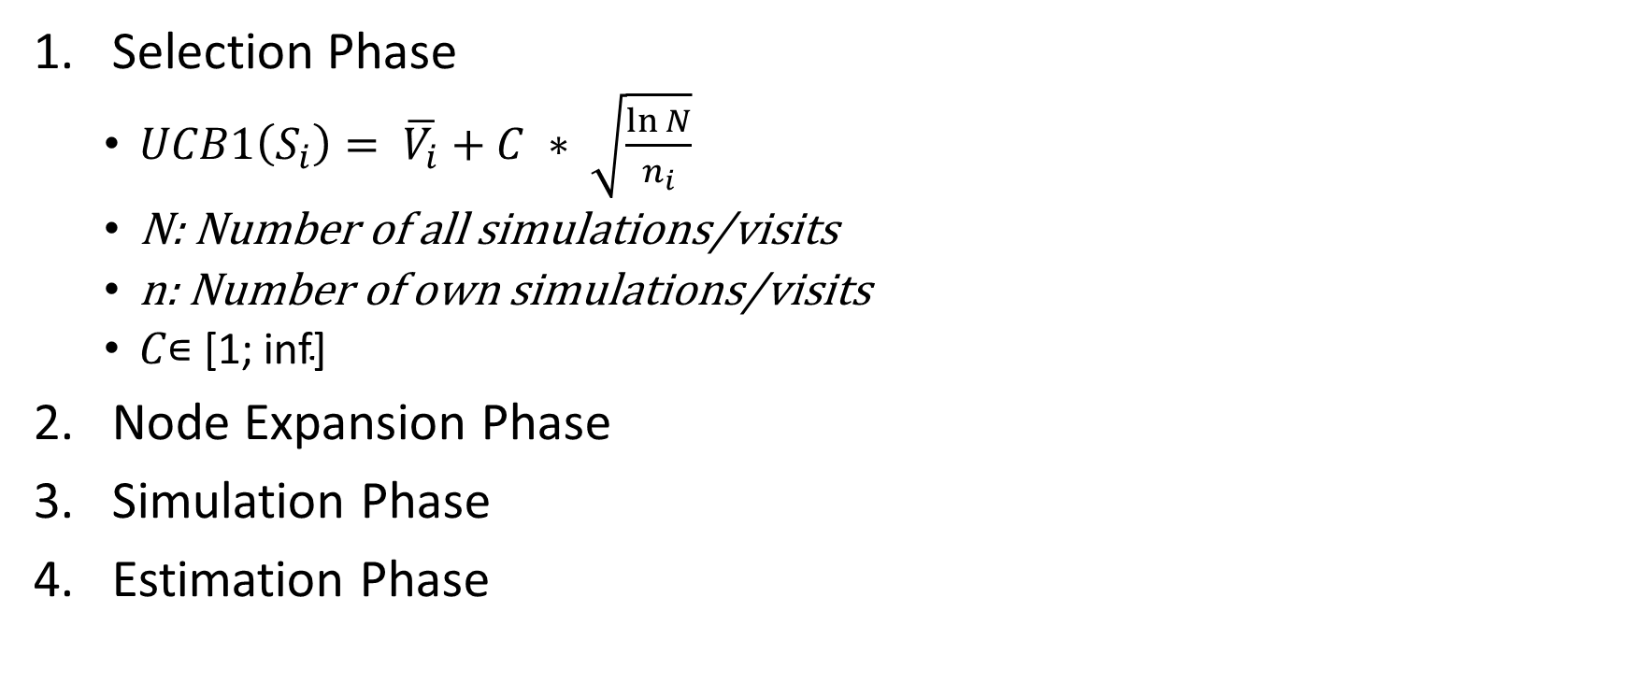
Different Operations
Selection Phase
  $UCB1\left(S_{i}\right)= \overline{V_{i}}+C ∗ \sqrt{\frac{\ln{N}}{n_{i}}}$
  N: Number of all simulations/visits
  n: Number of own simulations/visits
  $C\text{∊ [1; }\text{inf}\text{] }$
Node Expansion Phase
Simulation Phase
Estimation Phase

Slide 3
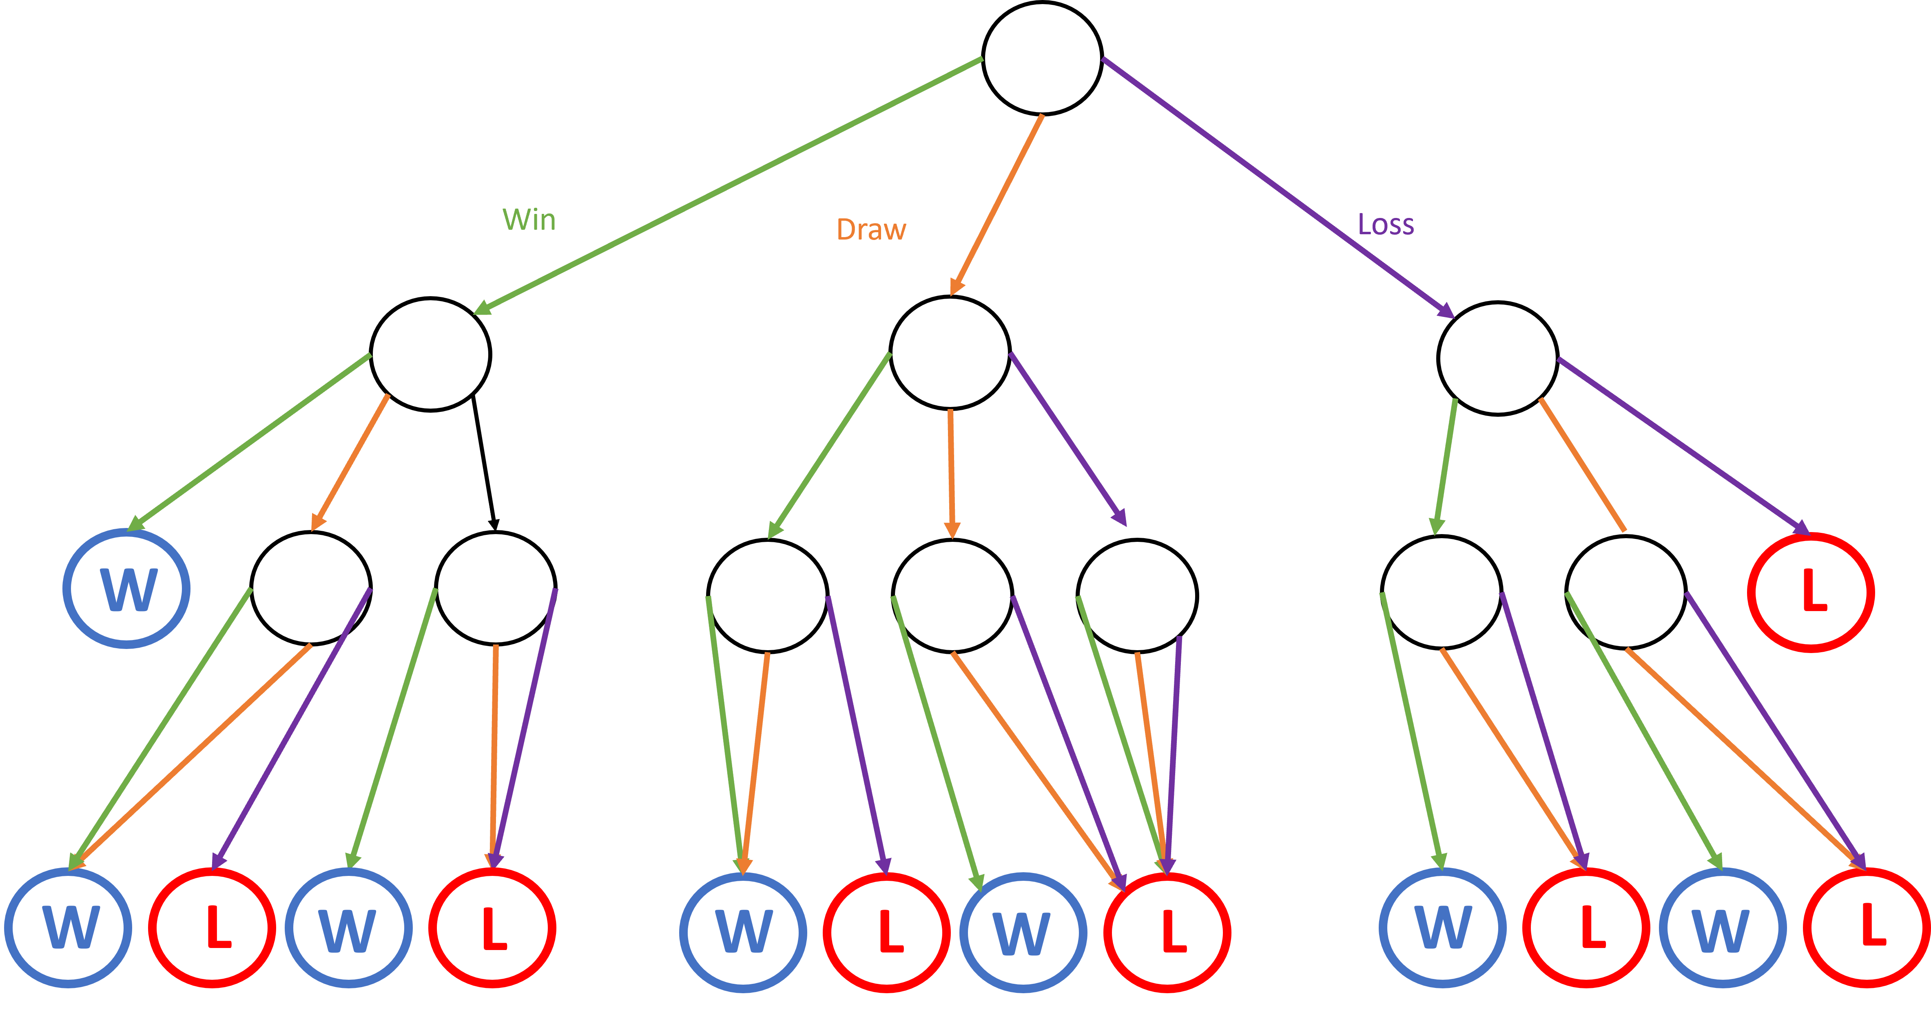
Rock, Paper, Scissors

Slide 4
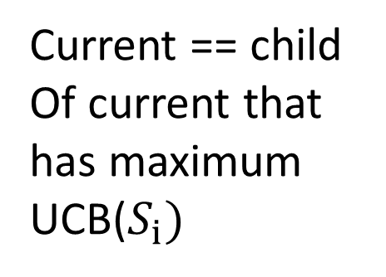
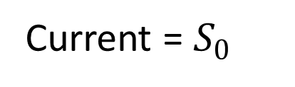
Algortihm
Simulation
Start
Yes
Current = $S_{0}$
Current already visited
Yes
No
Add as many children as there are actions to current
Current == Leaf
No
Current == child
Of current that has maximum UCB($S_{i})$
Current = first child
Simulation

Slide 5

Example (1/11)
$$S_{0}$$

Slide 6



Example (2/11)
$$S_{0}$$
$$S_{1}$$
$$S_{2}$$
$$S_{3}$$
Notes:
Expansion Phase

Slide 7
Example (3/11)
$$S_{0}$$
$$S_{1}$$
$$S_{2}$$
$$S_{3}$$
W

Slide 8
Example (4/11)
$$S_{0}$$
$$S_{1}$$
$$S_{2}$$
$$S_{3}$$
W
L
L
Notes:
Simulation Phase

Slide 9
Example (5/11)
$$S_{0}$$
$$S_{1}$$
$$S_{2}$$
$$S_{3}$$
0/1
1/1
0/1
W
L
L
Notes:
Estimation/update Phase
More estimations => more accurate

Slide 10
Example (6/11)
$$S_{0}$$
$$S_{1}$$
$$S_{2}$$
$$S_{3}$$
0/1
1/1
0/1
Notes:
Selection Phase

Slide 11



Example (7/11)
$$S_{0}$$
$$S_{1}$$
$$S_{2}$$
$$S_{3}$$
0/1
1/1
0/1
$$S_{4}$$
$$S_{5}$$
$$S_{6}$$
Notes:
Expansion Phase

Slide 12
Example (8/11)
$$S_{0}$$
$$S_{1}$$
$$S_{2}$$
$$S_{3}$$
0/1
1/1
0/1
$$S_{4}$$
$$S_{5}$$
$$S_{6}$$
W
L
L
Notes:
Simulation

Slide 13
Example (9/11)
$$S_{0}$$
$$S_{1}$$
$$S_{2}$$
$$S_{3}$$
0/1
2/4
0/1
$$S_{4}$$
$$S_{5}$$
$$S_{6}$$
0/1
1/1
0/1
W
L
L
Notes:
Estimation Phase

Slide 14







Example (10/11)
$$S_{0}$$
$$S_{1}$$
$$S_{2}$$
$$S_{3}$$
1/3
4/7
0/2
$$S_{4}$$
$$S_{7}$$
$$S_{9}$$
1/2
$$S_{5}$$
2/3
$$S_{6}$$
0/1
0/1
$$S_{8}$$
0/1
1/1
$$S_{4}$$
$$S_{11}$$
0/1
$$S_{10}$$
1/1
1/1
Notes:
After some iterations…

Slide 15
Example (11/11)
$$S_{0}$$
$$S_{1}$$
$$S_{2}$$
$$S_{3}$$
1/3
4/7
0/2
$$S_{4}$$
$$S_{7}$$
$$S_{9}$$
1/2
$$S_{5}$$
2/3
$$S_{6}$$
0/1
0/1
$$S_{8}$$
0/1
1/1
$$S_{4}$$
$$S_{11}$$
0/1
$$S_{10}$$
1/1
1/1
Notes:
Result:

Slide 16
Rock, Paper, Scissors

Slide 17
Win
Draw
Loss
W
L
W
L
W
L
W
L
W
L
W
L
W
L

